Slide 1

Distributed & Cloud Computing
Welcome
Sukkur IBA University
Week – 08
Lecture – 15&16
Your Facilitator, Adil Khan

Slide 2
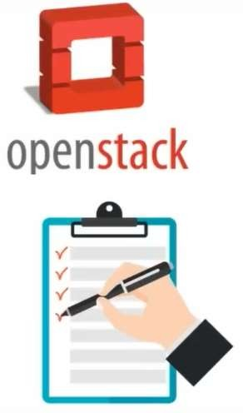
OpenStack Topics
What is OpenStack
Deployment Models
OpenStack Architecture
OpenStack Components

Slide 3
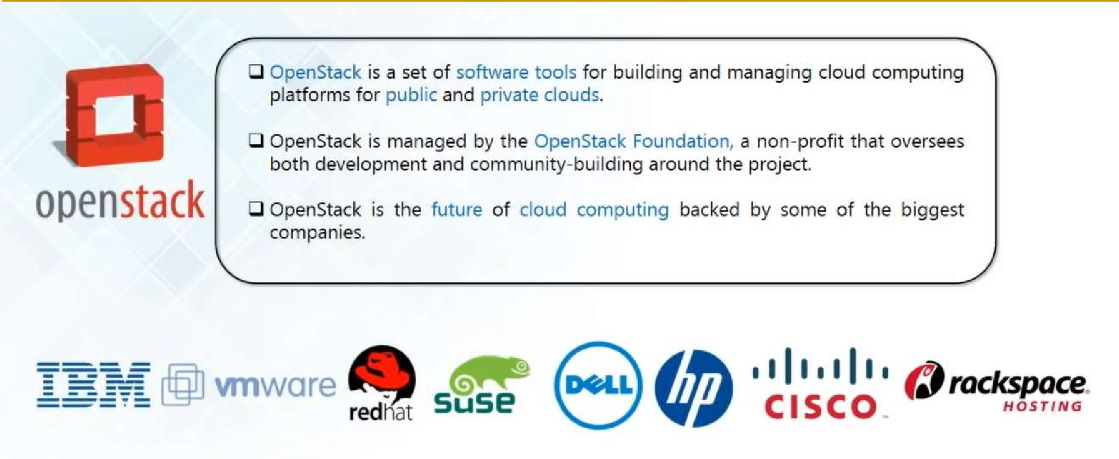
What is OpenStack?

Slide 4
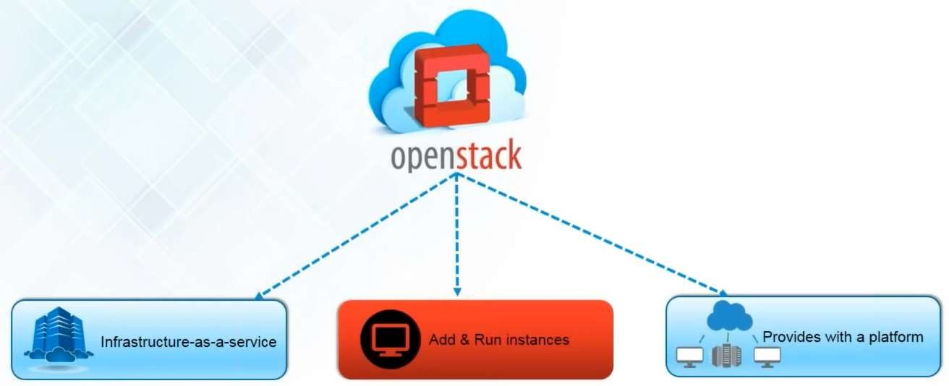
What is OpenStack?

Slide 5
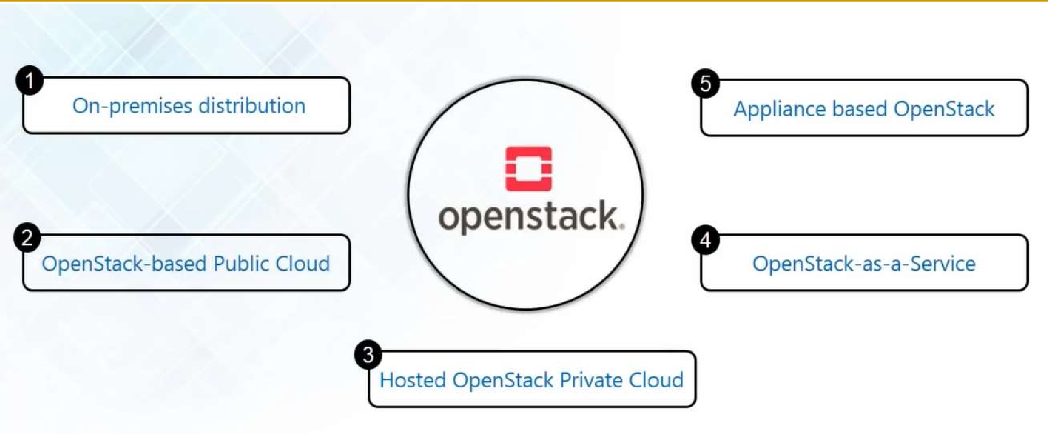
Deployment Models

Slide 6
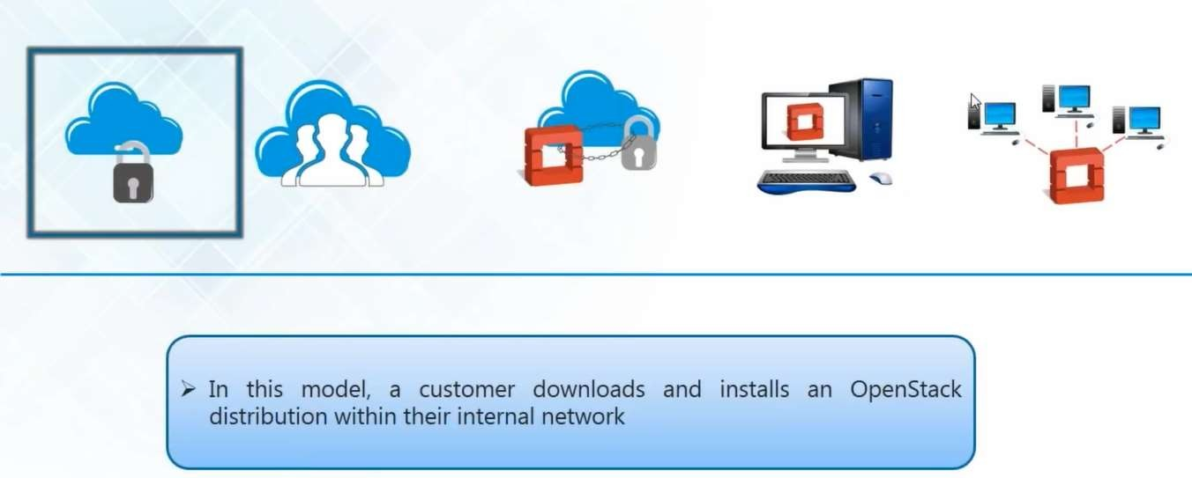
On-Premises Distribution

Slide 7
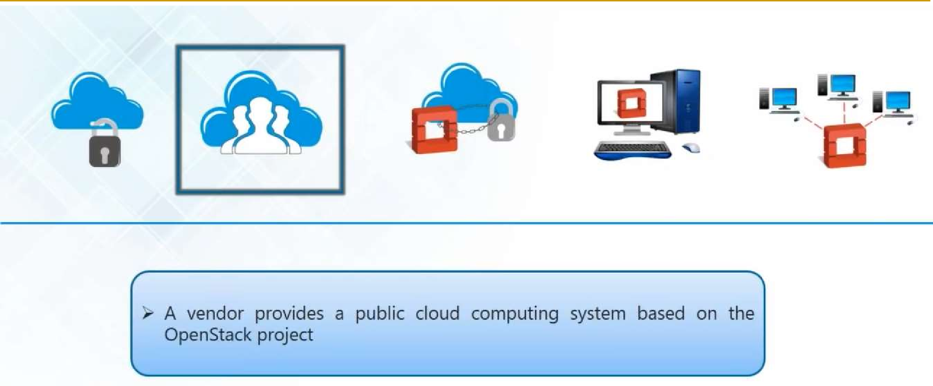
OpenStack-based Public Cloud

Slide 8
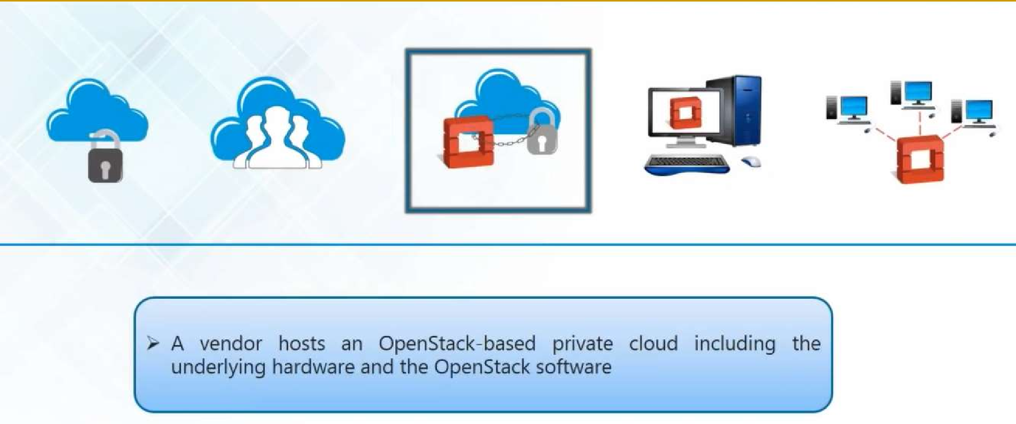
Hosted OpenStack Private Cloud

Slide 9
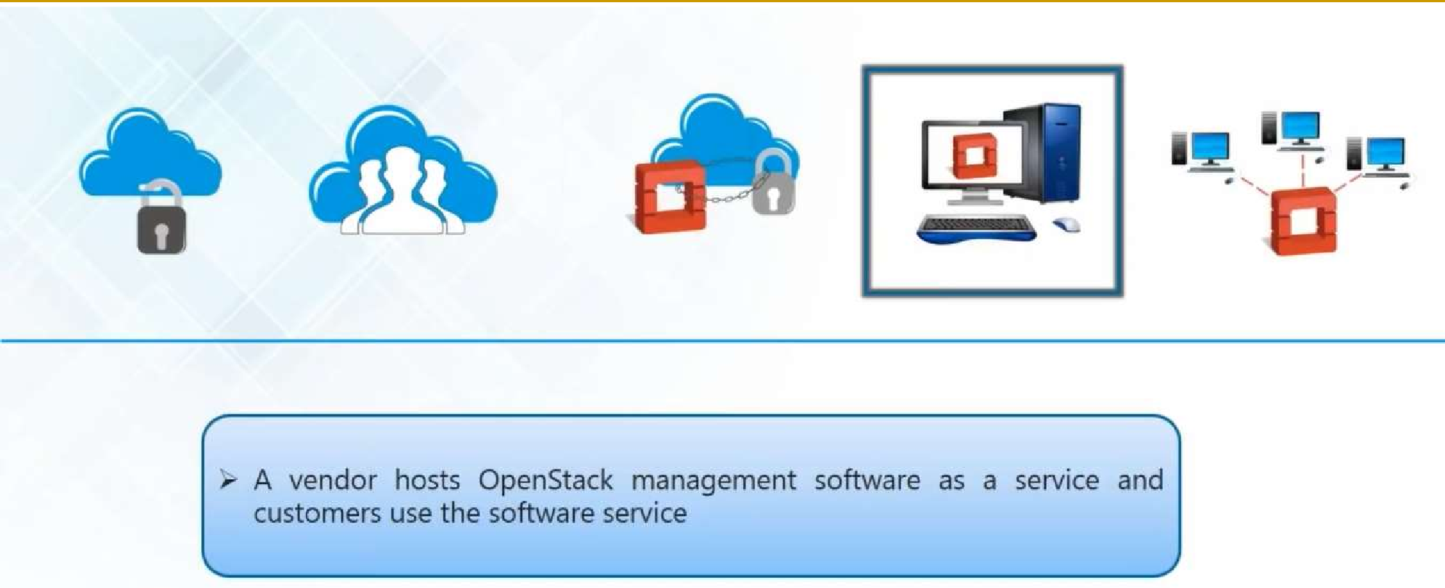
OpenStack as a Service

Slide 10
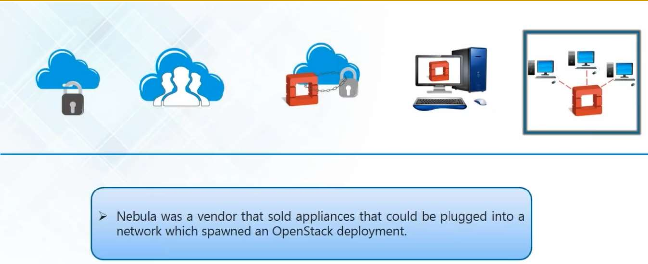
Appliance based OpenStack

Slide 11
OpenStack Architecture

Slide 12
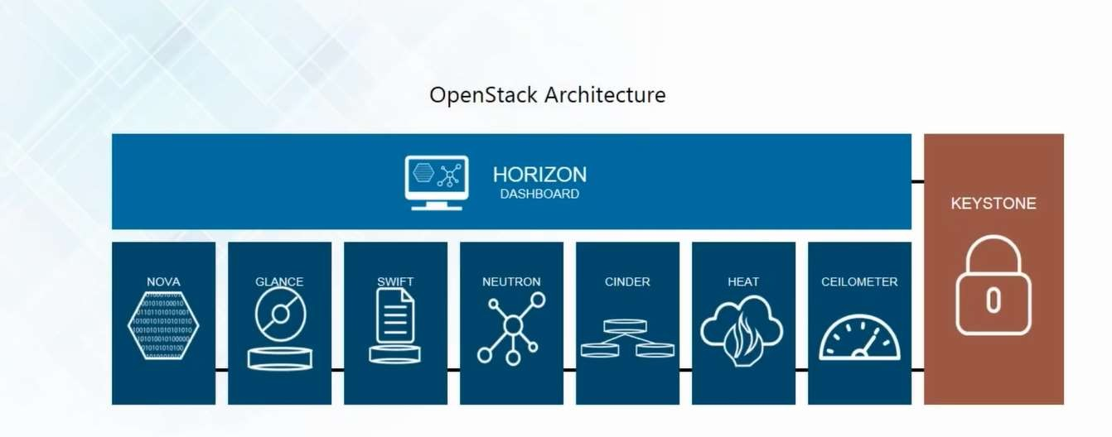
OpenStack Architecture

Slide 13
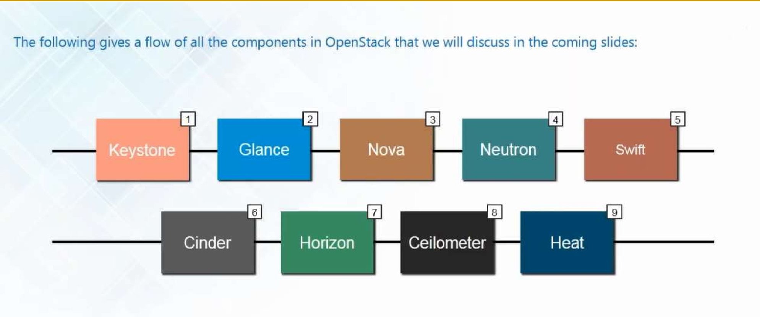
OpenStack Components/Projects

Slide 14
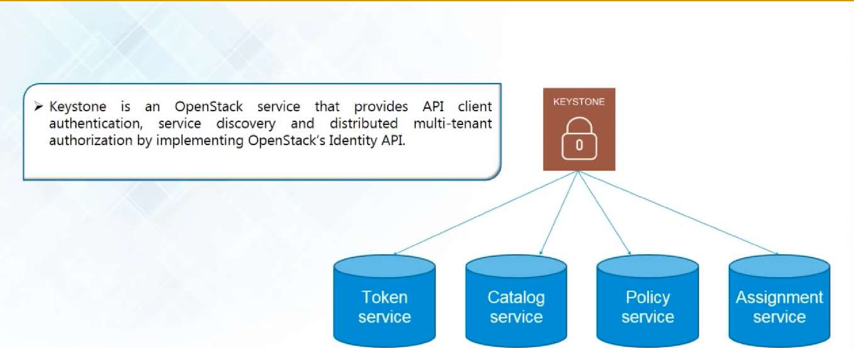
Keystone (Identity)

Slide 15
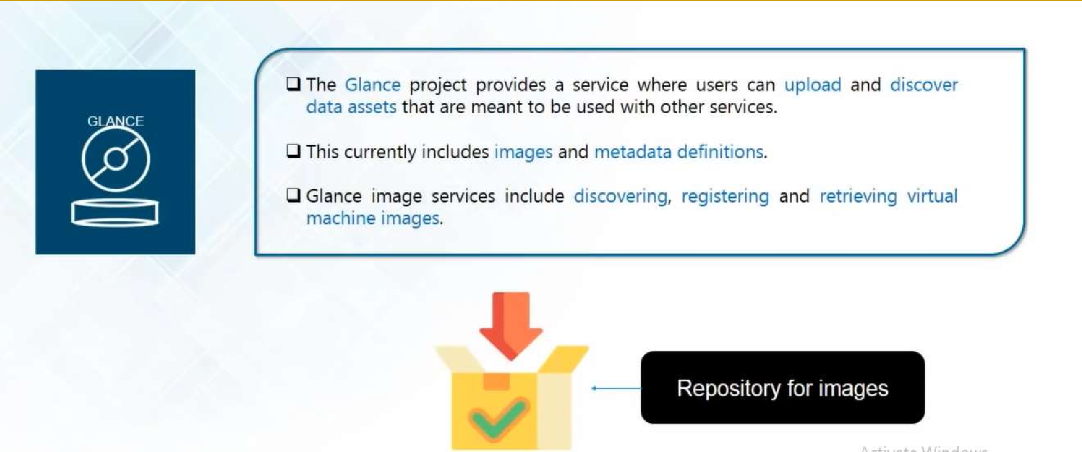
Glance (Image)

Slide 16
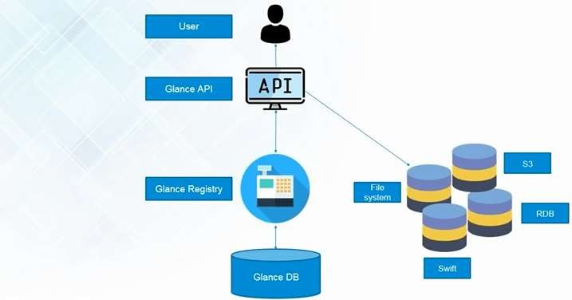
Glance (Image)

Slide 17
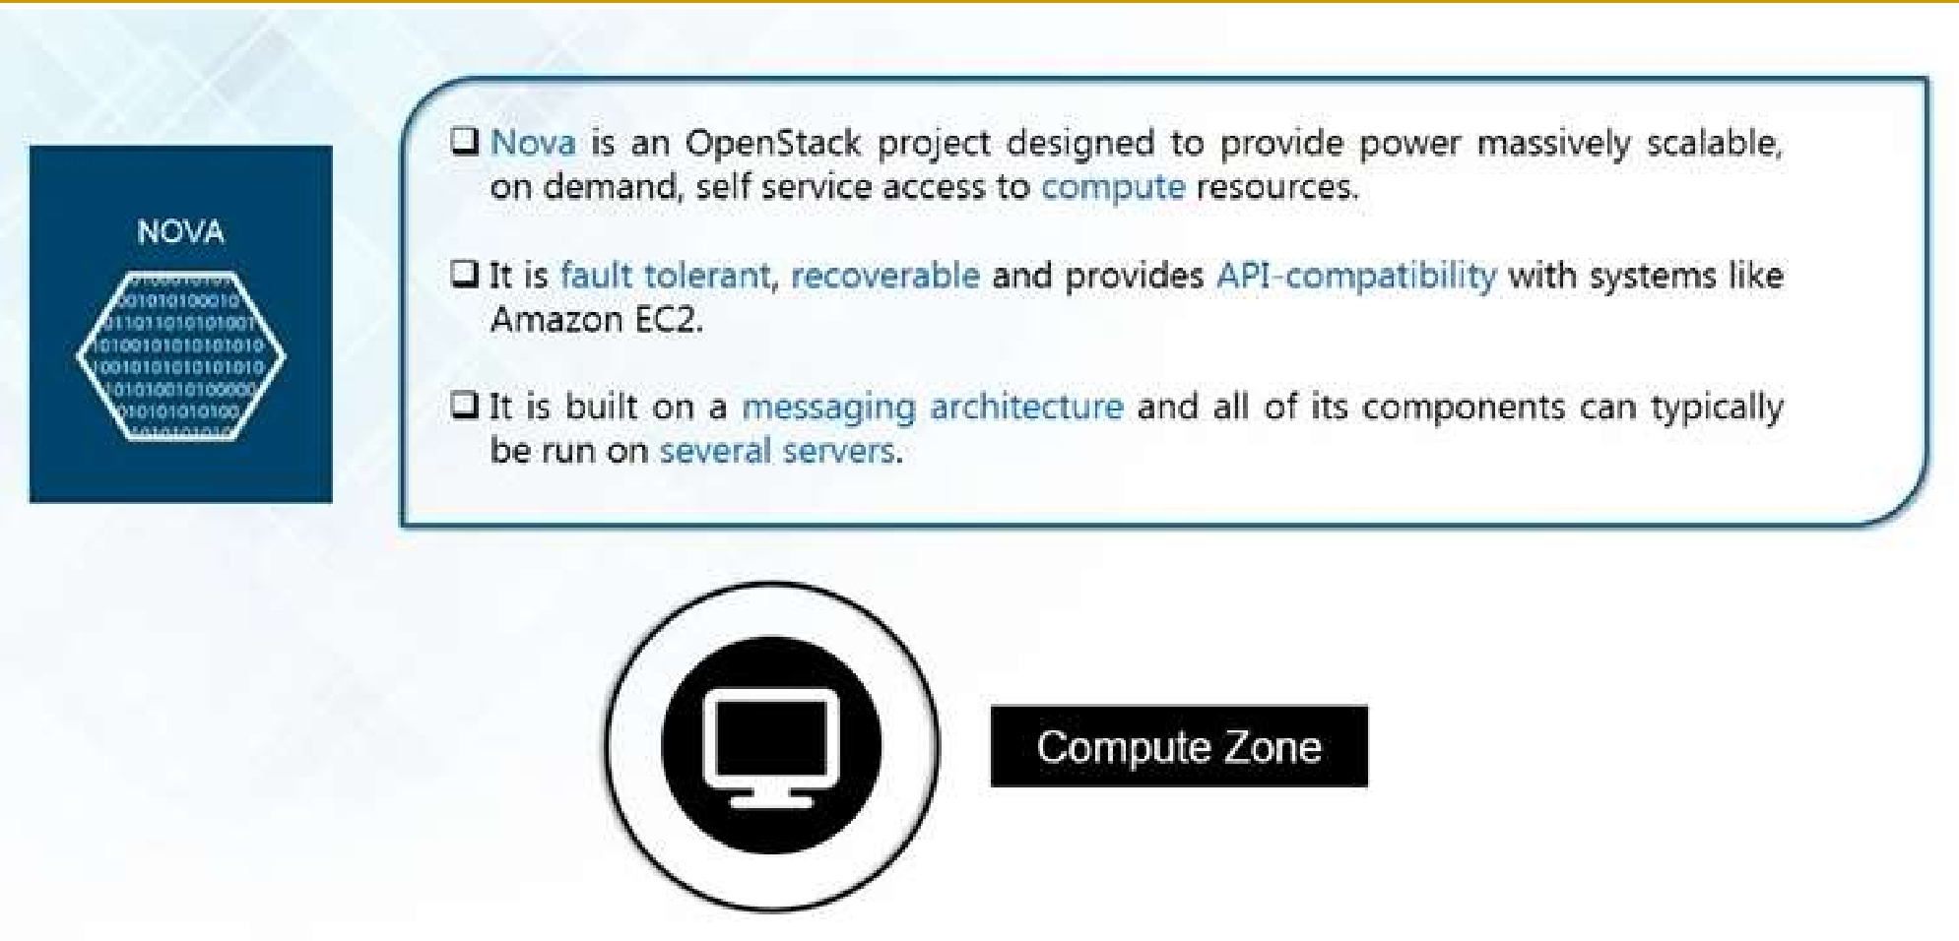
Nova (Compute)

Slide 18
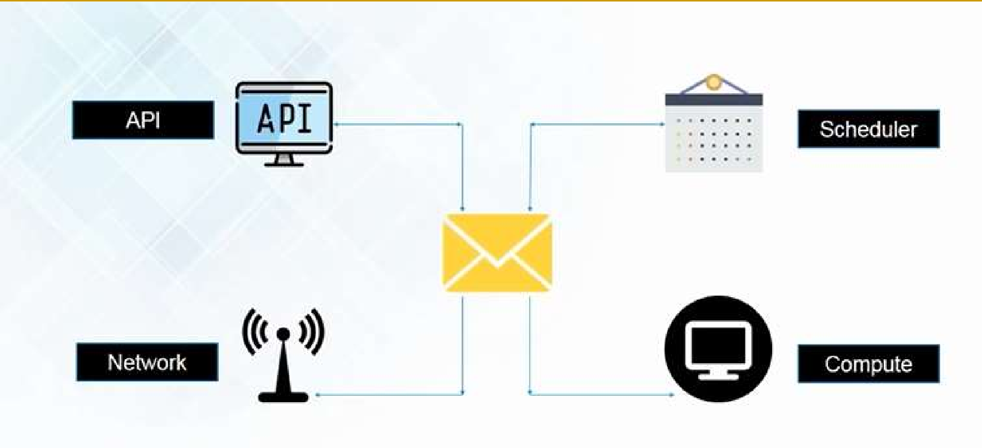
Nova (Compute)

Slide 19
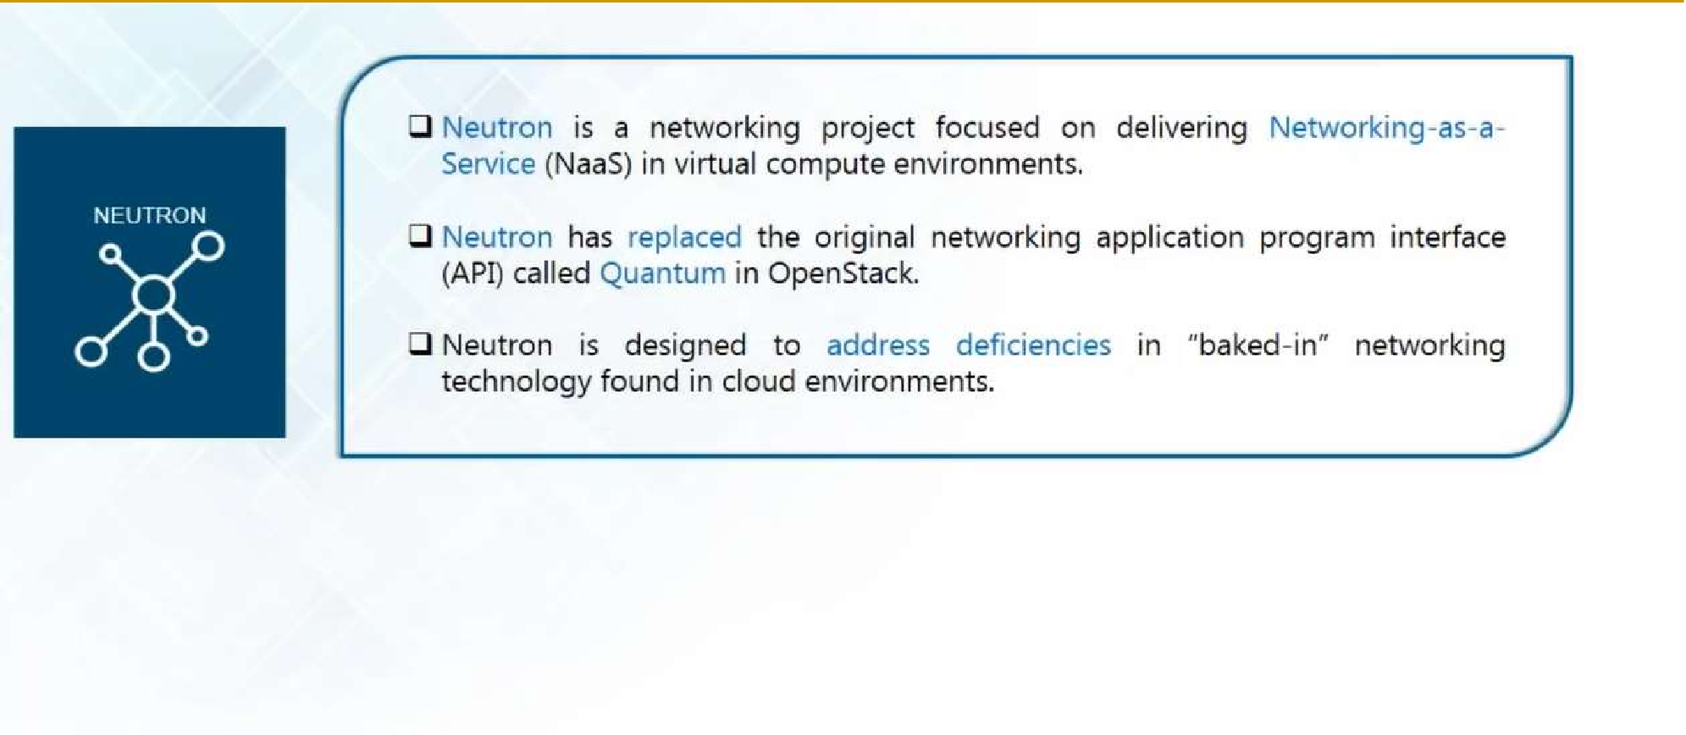
Neutron (Network)

Slide 20
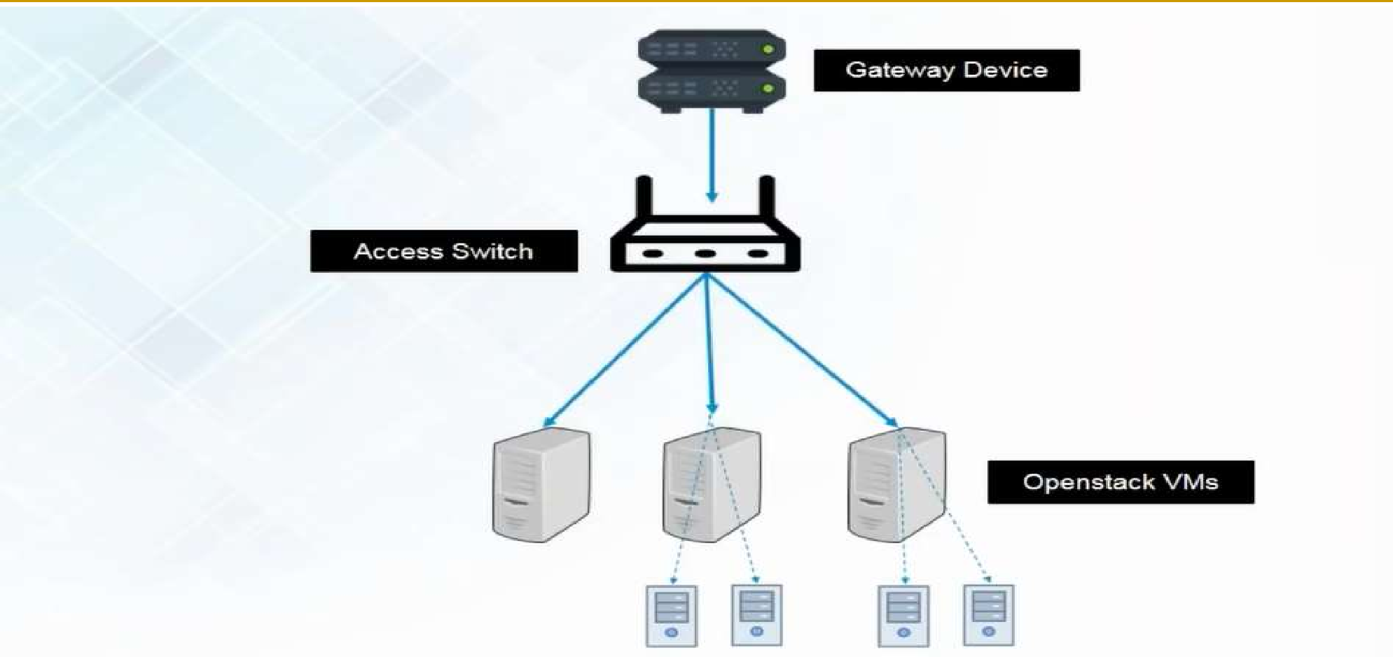
Neutron (Network)

Slide 21
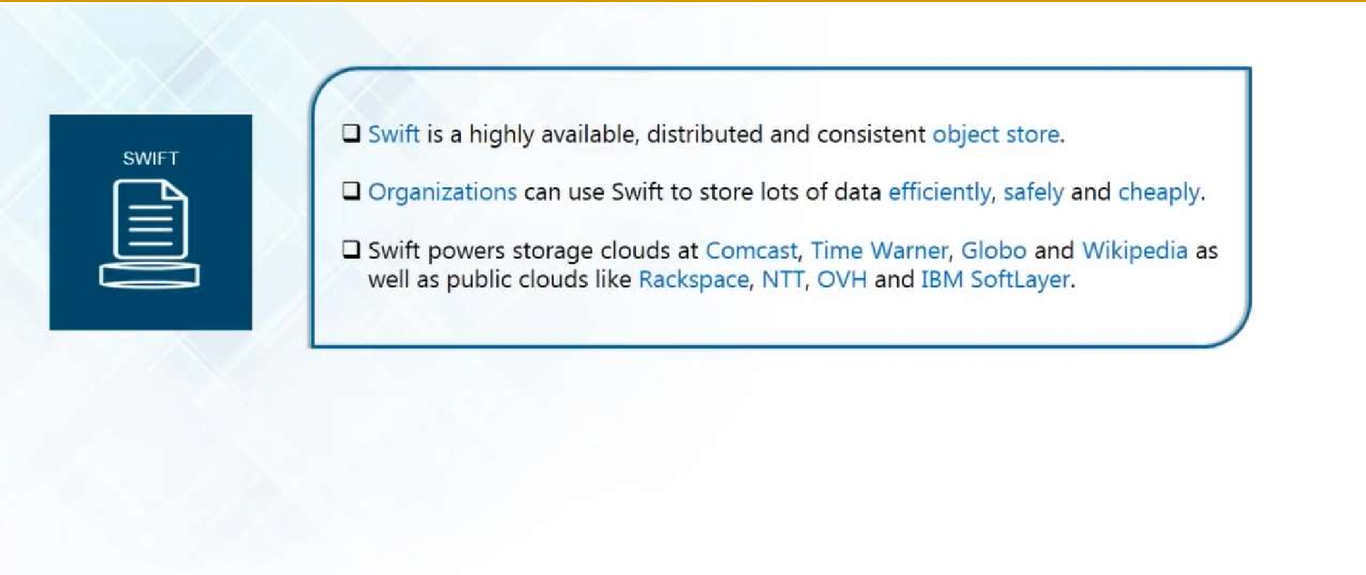
Swift (Object Storage)
20

Slide 22
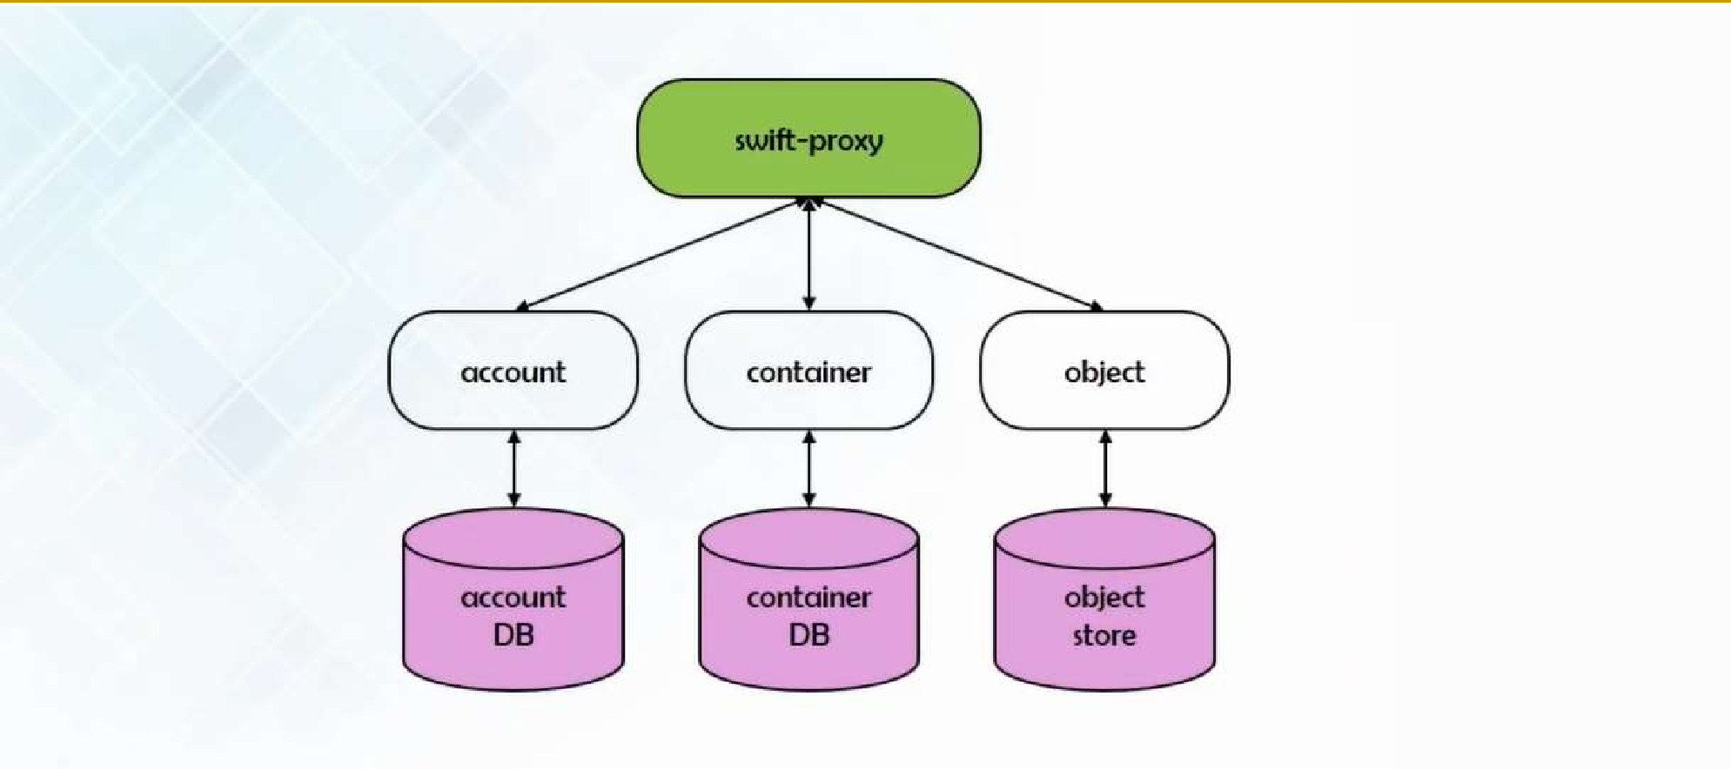
Swift (Object Storage)

Slide 23
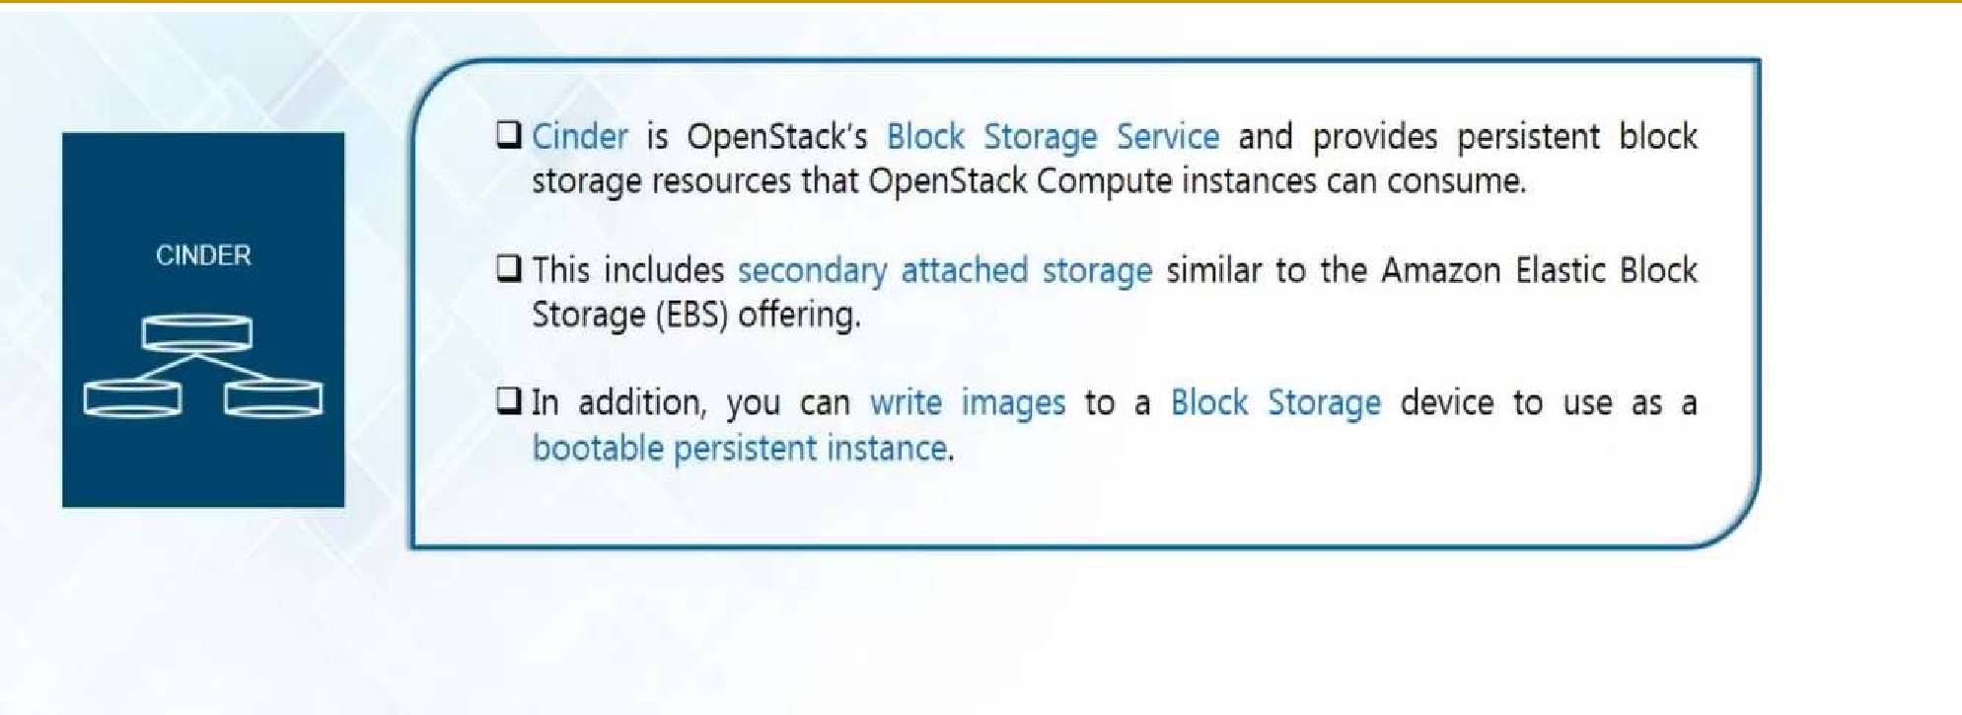
Cinder (Block Storage)

Slide 24
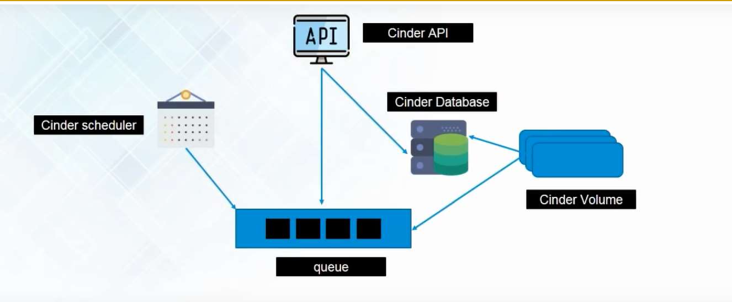
Cinder (Block Storage)

Slide 25
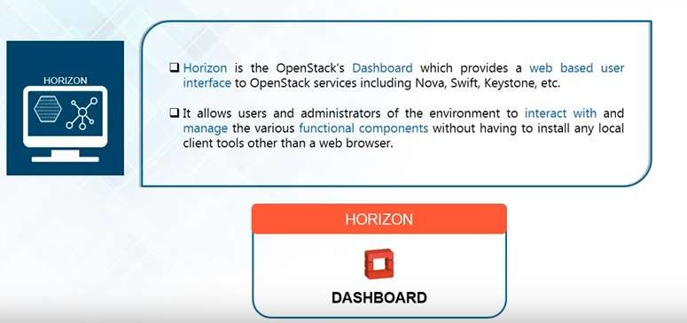
Horizon (Dashboard)

Slide 26
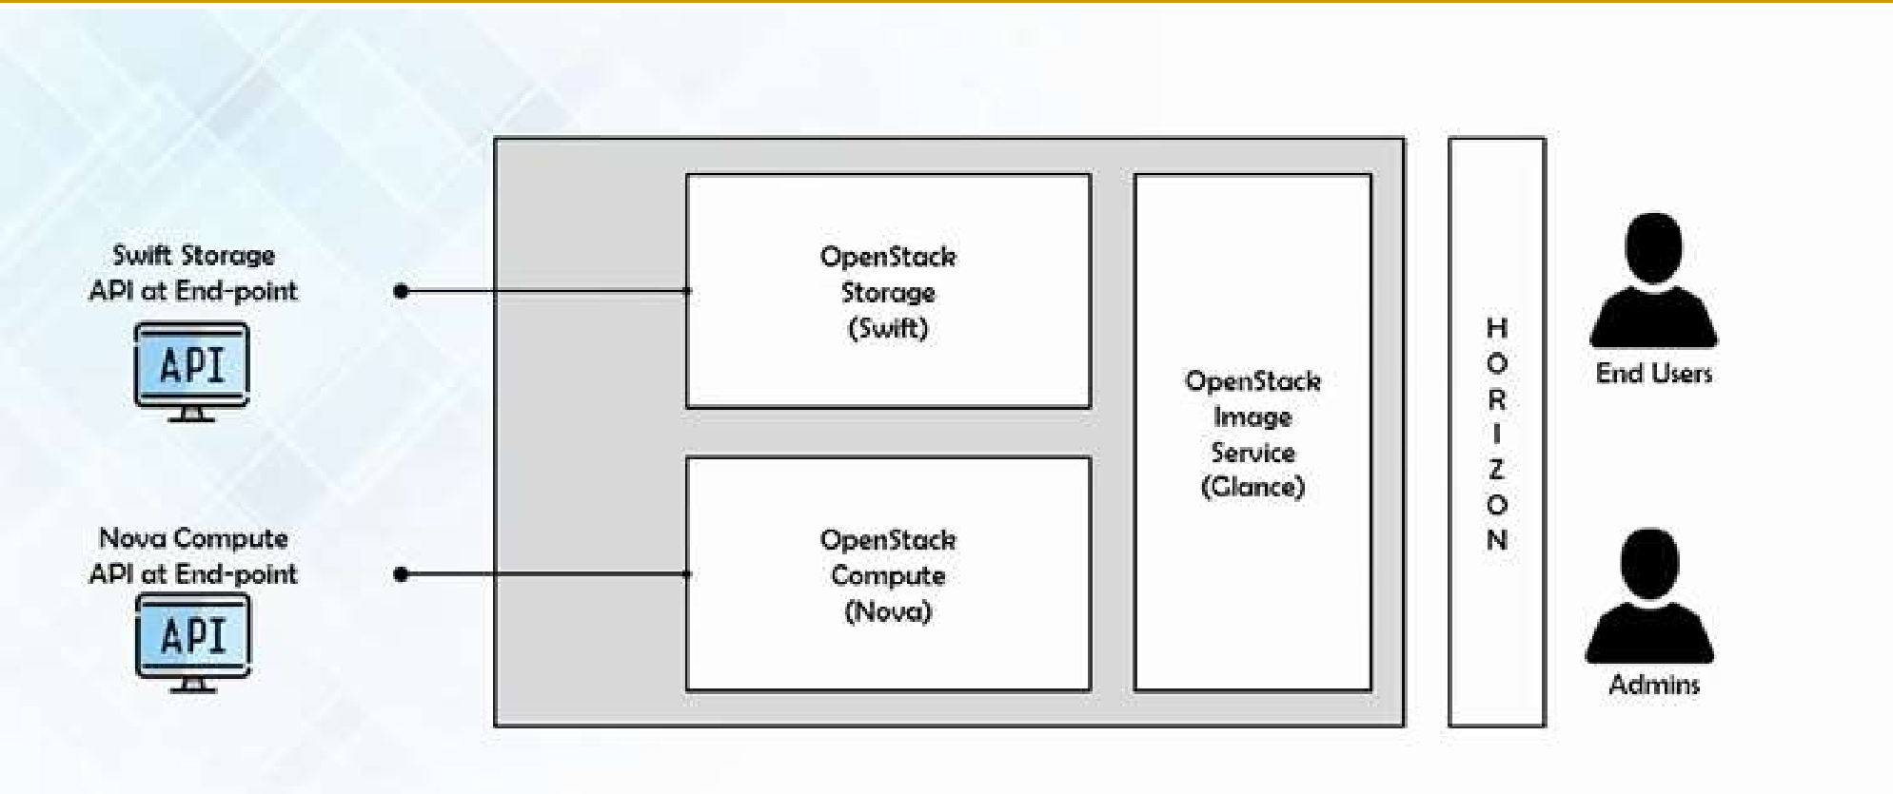
Horizon (Dashboard)

Slide 27
Thank you!
Any Questions???

